Slide 1
CSE 3100: Systems Programming
Part 4
Lecture 2: Client Server Syntax
Professor Kaleel Mahmood
Department of Computer Science and Engineering
University of Connecticut

Slide 2
Administrative Announcements
Lab 9 will be held this week. This is the last lab.
We will have exam 3 in lab April 26th. There is no make up for this exam 3.
NO final exam for the course (hooray!).
The extra credit project will be assigned finals week.

Slide 3

The SET Survey
Please complete it here: https://bpir.uconn.edu/home/institutional-research/set/
What you should consider:
Our lectures used SIMPLE, EFFECTIVE coding examples in the slides.
Do you want student’s experience to improve? If so, give feedback.
If 70% of the students take the survey we will drop a second homework grade.

Slide 4
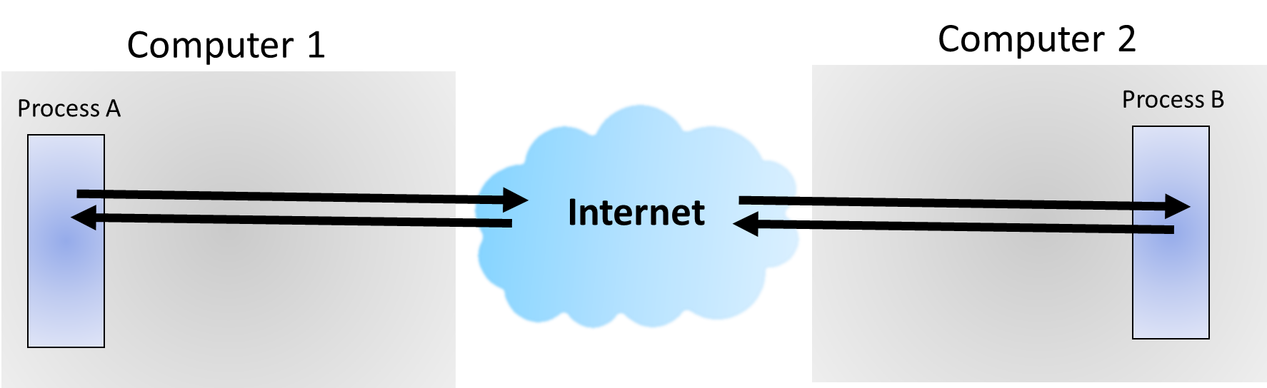
Review: Socket Design Motivation
How to communicate between processes running on different machines?
AND how to communicate between different processes that don’t have the parent/child relation?
Answer: Use the sockets to coordinate sending and receiving data.
This is done via the internet if the processes are on different machines.

Slide 5
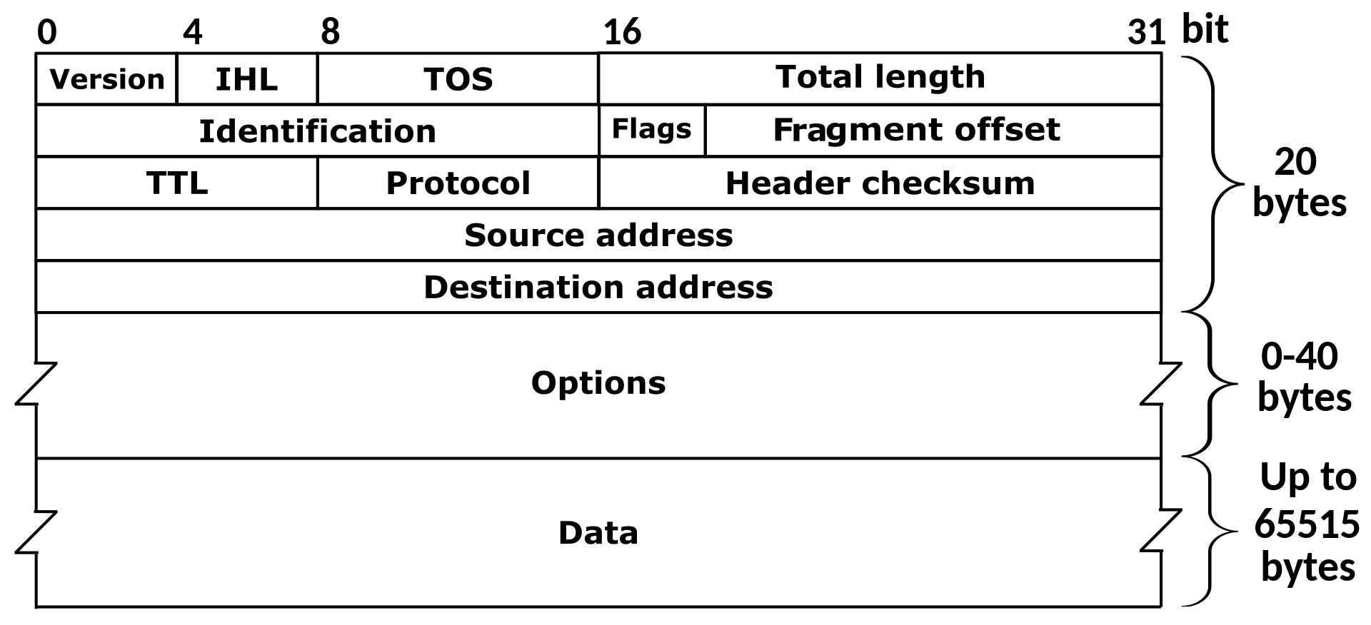
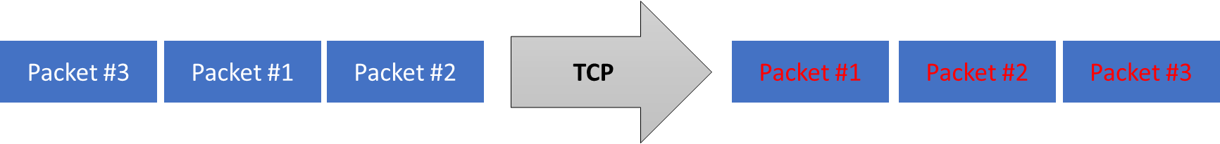
Review: TCP/IP (Transmission Control Protocol/Internet Protocol)
Internet Protocol (IP): addressing and routing of one packet.
Transmission Control Protocol (TCP): handle the multi-packet case where issues like order of arrival, or dropped packets may happen.
The goal is to have reliable communication achieved with TCP over IP.

Slide 6
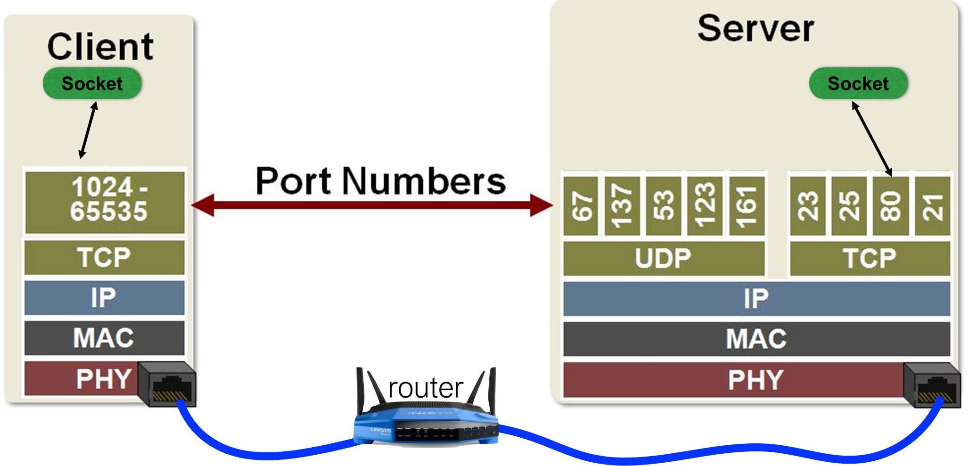
Review: Sockets - The abstraction to access ports and utilize TCP/IP.

Slide 7
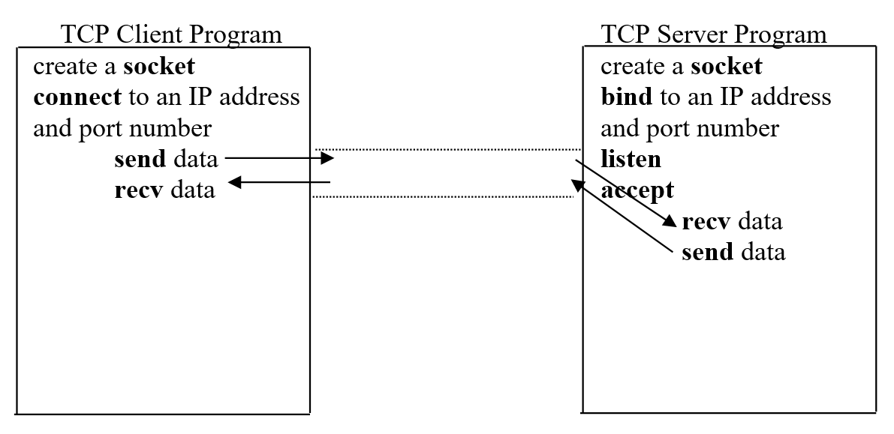
Review: using socket program to setup a simple client server program

Slide 8
Creating a Socket

Slide 9
Syntax: Creating a Socket (1)
#include <sys/types.h>
#include <sys/socket.h>
int socket(int domain, int type, int protocol);
Specifies communication domain
AF_ LOCAL - For communication between processes on the same host.
AF_INET - For communicating between processes on different hosts connected by IPV4.
AF_INET6 - For processes connected by IPV6.
Source: https://www.geeksforgeeks.org/socket-programming-cc/#

Slide 10
Syntax: Creating a Socket (2)
#include <sys/types.h>
#include <sys/socket.h>
int socket(int domain, int type, int protocol);
Communication type SOCK_STREAM: TCP(reliable, connection oriented) SOCK_DGRAM: UDP(unreliable, connectionless)
UDP =User Datagram Protocol

Slide 11
Syntax: Creating a Socket (3)
#include <sys/types.h>
#include <sys/socket.h>
int socket(int domain, int type, int protocol);
Protocol value for Internet Protocol(IP), which is 0

Slide 12
Syntax: Creating a Socket (4)
#include <sys/types.h>
#include <sys/socket.h>
int socket(int domain, int type, int protocol);
Returns a file descriptor for the given domain, type, and protocol.
Returns -1 on error.
// Use close() to close a socket

Slide 13
Binding
Two concepts:
The binding function call
The IP address

Slide 14
Syntax: Binding (1)
After the creation of the socket, the bind function binds the socket to the address and port number specified in addr(custom data structure).
#include <sys/types.h>
#include <sys/socket.h>
int bind(int sockfd, const struct sockaddr *addr, socklen_t addrlen);
Source: https://www.geeksforgeeks.org/socket-programming-cc/#c

Slide 15
Syntax: Binding (2)
#include <sys/types.h>
#include <sys/socket.h>
int bind(int sockfd, const struct sockaddr *addr, socklen_t addrlen);
If successful, bind() returns 0
If unsuccessful, bind() returns -1

Slide 16
Syntax: Binding (3)
#include <sys/types.h>
#include <sys/socket.h>
int bind(int sockfd, const struct sockaddr *addr, socklen_t addrlen);
File descriptor integer of the socket.

Slide 17
Syntax: Binding (4)
#include <sys/types.h>
#include <sys/socket.h>
int bind(int sockfd, const struct sockaddr *addr, socklen_t addrlen);
What is struct sockaddr?
It holds address information for many types of socket.
Hence we need a separate addrlen to indicate its size.
Length of the address

Slide 18
Syntax: Binding - Socket Address
//generic socket address
struct sockaddr {
//address family, AF_xxx
unsigned short sa_family;
//14 byte protocol address. Place holder
char sa_data[14];
};
// we are using Internet socket address
struct sockaddr_in sa; // socket address IPv4
struct sockaddr_in6 sa6; // socket address IPv6
We’ll cover more about finding socket addresses and using them when we talk about connecting on the client side…

Slide 19
Listen

Slide 20
Syntax: Listen
//listen function
int listen(int sockfd, int backlog);
listen() puts the server socket in a passive mode.
Server listens on the socket specified by sockfd.
Server waits for the client to approach the server to make a connection.
The backlog defines the maximum length to which the queue of pending connections for sockfd may grow.
If a connection request arrives when the queue is full, the client may receive an error with an indication of ECONNREFUSED.
Source: https://www.geeksforgeeks.org/socket-programming-cc/#c

Slide 21
Accept

Slide 22
Syntax: Accept (1)
int = accept(int sockfd, struct sockaddr *addr, socklen_t *addrlen);
When the accept function is called, it blocks the code from proceeding until a connection requests comes from a client.
Source: https://www.ibm.com/docs/en/zos/2.3.0?topic=functions-accept-accept-new-connection-socket

Slide 23
Syntax: Accept (2)
int = accept(int sockfd, struct sockaddr *addr, socklen_t *addrlen);
The accept() call creates a new socket descriptor with the same properties as socket and returns it to the caller.

Slide 24
Syntax: Accept (3)
int = accept(int sockfd, struct sockaddr *addr, socklen_t *addrlen);
The socket on which the server is listening.

Slide 25
Syntax: Accept (4)
int = accept(int sockfd, struct sockaddr *addr, socklen_t *addrlen);
The socket address of the connecting client.
It is filled in by accept() before it returns.
The format of address is determined by the domain that the client resides in.

Slide 26
Syntax: Accept (5)
int = accept(int sockfd, struct sockaddr *addr, socklen_t *addrlen);
Different domains use different address formats.
Hence we need a length parameter to know the size of the address we are going to fill in.
Points to a socklen_t variable which is essentially a special integer and contains the size in bytes of the storage pointed to by address.

Slide 27
Client Server Overview
Next we’ll go through the syntax of functions for the clients.

Slide 28
Creating a Socket

Slide 29
Syntax: Creating a Socket
#include <sys/types.h>
#include <sys/socket.h>
int socket(int domain, int type, int protocol);
Syntax already covered when explaining the server.
You already know!

Slide 30
Connect to an IP address

Slide 31
Syntax: Connect to an IP address (1)
#include <sys/socket.h>
int connect(int socket, const struct sockaddr *address, socklen_t address_len);
The socket descriptor on the client side

Slide 32
Syntax: Connect to an IP address (2)
#include <sys/socket.h>
int connect(int socket, const struct sockaddr *address, socklen_t address_len);
The length of the address
The socket address of the server.
But how does the client know the address of the server and which port to use?

Slide 33
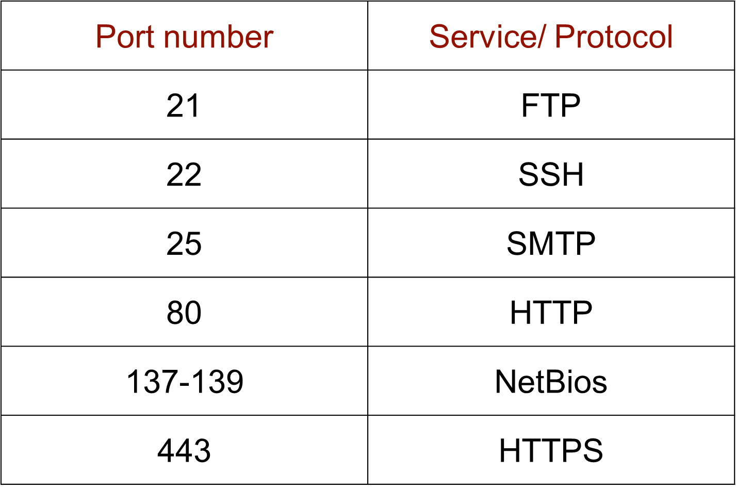
How does the client know which port to use?
For port number: The server will typically use a certain port number depending on the service offered. Client should know what service they want.
Commonly used TCP port numbers:
HTTP = Hyper Transfer Protocol

Slide 34
How does the client know which IP address to use?
To help us figure this out, we have a structure associated with the address for the server:
// A recent invention for preparing the socket address
//AI = Address Information
struct addrinfo {
int ai_flags; // AI_PASSIVE, AI_CANONNAME, etc.
int ai_family; // AF_INET, AF_INET6, AF_UNSPEC
int ai_socktype; // SOCK_STREAM, SOCK_DGRAM
int ai_protocol; // use 0 for "any"
size_t ai_addrlen; // size of ai_addr in bytes
struct sockaddr *ai_addr; // struct sockaddr_in or _in6
char *ai_canonname; // full canonical hostname
struct addrinfo *ai_next; // linked list, next node
};

Slide 35
Follow up question: How do we fill in the addrinfo structure?
int getaddrinfo(const char *node, // "www.example.com" or IP
const char *service, // "http" or port #
const struct addrinfo *hints,
struct addrinfo **res);
This function finds addrinfo for you!
Provide you a linked-list, res. A list of results!
node is the host name to connect to, or an IP address.
service can be a port number, like “80”, or the name of a particular service like “http” or “ftp” or “telnet” or “smtp”, etc.
hints points to a struct addrinfo that you've already filled out with relevant information.
For more details see: https://man7.org/linux/man-pages/man3/getaddrinfo.3.html

Slide 36
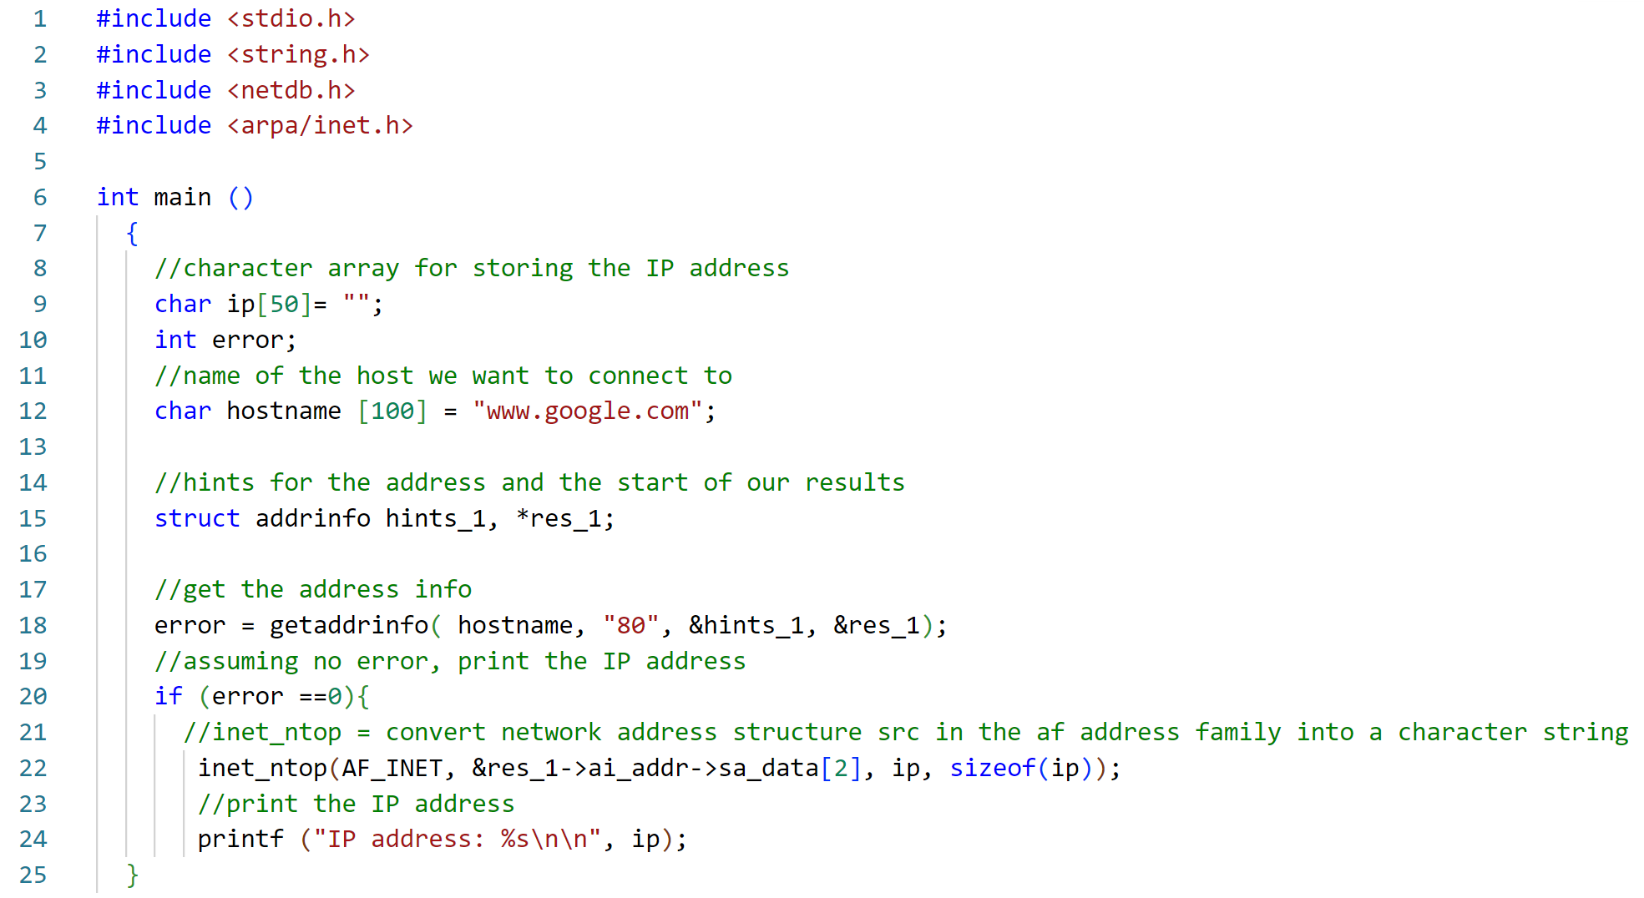
Example Code: Finding an IP address
Netdb = Library for network database operations.
Arpa = Library for internet operations.
Source: https://pubs.opengroup.org/onlinepubs/7908799/xns/arpainet.h.html
https://pubs.opengroup.org/onlinepubs/7908799/xns/netdb.h.html
Source Code: https://linuxhint.com/c-getaddrinfo-function-usage/

Slide 37
Example Code: Finding an IP address
Here we want to find Google’s IP address.

Slide 38

Example Code: Finding an IP address
Provide an address information structure with hints about what we already know.
Do we know any hints?

Slide 39
Example Code: Finding an IP address
Check for the host name’s IP address using port 80 (the http port) with the empty hints structure and the results.
Why do we use a pointer to a pointer for res_1?

Slide 40
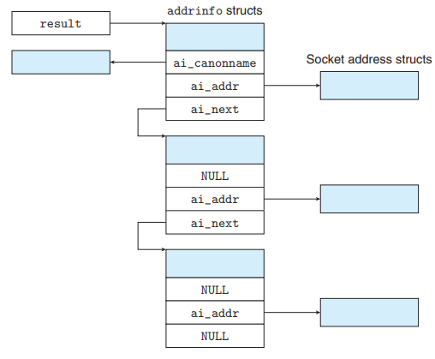
Why do we use a pointer to a pointer for res_1?
res_1 is a pointer to a pointer. This essentially means we have a way to get the first element of a linked list of address info structures.
This link list contains all related address from the host name. For example, high traffic sites may use multiple IP addresses and give different IPs to different visitors.
Figure Source: https://stackoverflow.com/questions/64238919/understanding-getaddrinfo-function-in-c

Slide 41
Example Code: Finding an IP address
Lastly, print the IP address.

Slide 42
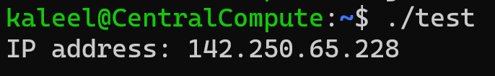
Example Code: Finding an IP address
Sample Run:

Slide 43
Recall where we were: Client Server Overview
Lastly we’ll go through the syntax of send/recv

Slide 44
send for TCP
#include <sys/types.h>
#include <sys/socket.h>
ssize_t send(int sfd, const void *buf, size_t len, int flags);
Return the number of bytes that have been sent.
Sent does not mean delivered!
Returns -1 on errors

Slide 45
send for TCP
#include <sys/types.h>
#include <sys/socket.h>
ssize_t send(int sfd, const void *buf, size_t len, int flags);
Socket file descriptor on which the client and server are connected.

Slide 46
send for TCP
#include <sys/types.h>
#include <sys/socket.h>
ssize_t send(int sfd, const void *buf, size_t len, int flags);
Pointer to the buffer containing the message to send.

Slide 47
send for TCP
#include <sys/types.h>
#include <sys/socket.h>
ssize_t send(int sfd, const void *buf, size_t len, int flags);
Length of the message pointed to by the previous parameter.

Slide 48
send for TCP
#include <sys/types.h>
#include <sys/socket.h>
ssize_t send(int sfd, const void *buf, size_t len, int flags);
Specifies the type of message transmission. For this class just assume this parameter will be provided to you.

Slide 49
recv for TCP
The receive function is very similar to the send function...
#include <sys/types.h>
#include <sys/socket.h>
ssize_t recv(int sfd, void *buf, size_t len, int flags);

Slide 50
Using the Send and Receive Function
Only after a connection is established!
// To send n bytes stored in buf
sent = 0;
while (sent < n) {
int r = send(sid, buf + sent, n - sent, 0);
if (r < 0) report_error();
sent += r;
}

Slide 51
Using the Send and Receive Function
Only after a connection is established!
// To receive n bytes into buf
received = 0;
while (received < n) {
int r = recv(sid, buf + received, n - received, 0);
if (r < 0) report_error();
received += r;
}

Slide 52

Client Server Code Recap
The whole class after the client server lecture:

Slide 53
Analogy Between Sockets and Telephone
 | Sockets | Telephone
socket() | Create a socket | Buy a telephone
bind() | Bind to a port | Plug in/Insert a Sim
listen() | Get ready to respond | Get ready for ringtone
accept() | Accept requests | Pick up the phone
send()/recv() | Communication | Listen and talk (at an extension)
close() | Close the connection | Hang up

Slide 54
Client Server Code Recap
In the first lecture in part 4 we showed the entire client server code setup (pretending we knew the syntax).
In THIS lecture we actually went over the syntax that makes the code work.

Slide 55
Lastly: Seeing the client server code run…
Recall our client server setup:
Client: Connects to the server and sends a text message.
Server: Listens and waits for a message from the client. When it gets the message, it prints the message on the terminal.
Note: The full example client server code will be posted on HuskyCT. The main pieces of code were also shown in part 4 lecture 1.
Strongly recommended you try running the code yourself and reading through it to make sure you have a good understanding.

Slide 56
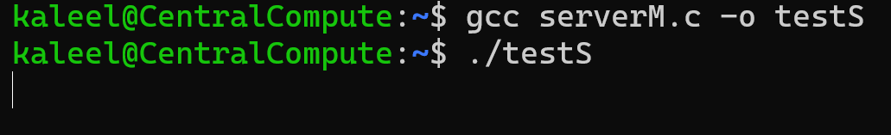

First: Start the server up in one terminal…
Server Terminal
Our Server

Slide 57
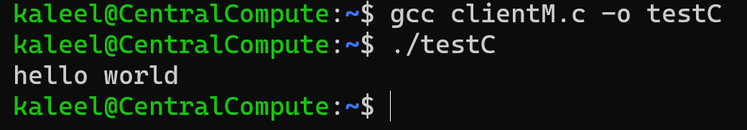
Second: Start the server up in another terminal…
Server Terminal
Client Terminal

Slide 58
Third: Type a message to send to the server after the connection has been established
Server Terminal
Client Terminal

Slide 59
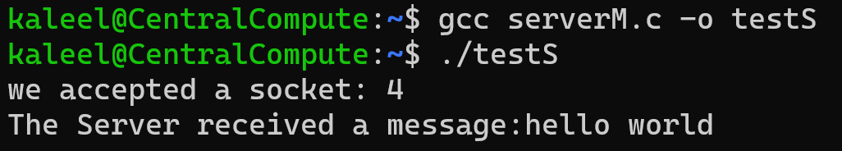
Fourth: Check the server and see that we go the message
Server Terminal
Client Terminal

Slide 60
Figure Sources
https://media.tenor.com/BTNqvs8t9SUAAAAM/ok-you-know-it.gif
https://media.makeameme.org/created/ill-have-you-103eog.jpg
https://ychef.files.bbci.co.uk/1280x720/p03lcphh.jpg
https://media.makeameme.org/created/im-listening-syz9iq.jpg

